Slide 1
Chemistry – Oct 11, 2019
P3 Challenge-
Pretend you need to separate a mixture of sand, iron filing and salt. Briefly describe the strategy you will use to separate these three substances using a flow chart.
Objective –
Kinetic Theory of Gases
Pressure, Temperature
PT Phase Diagrams

Slide 2
Chemistry – Oct 11, 2019
Agenda –
Kinetic Molecular Theory of Gases
Temperature units
Pressure and Pressure units
Standard Temperature and Pressure (STP)
Phase Diagrams
Assignment: -
Pressure- Temperature Worksheet
Complete the Separation Lab report, due Monday Oct 14

Slide 3
Kinetic Theory of Gases
1) A gas is a collection of particles in continuous, random motion with constant velocity (constant speed in straight-line motion, though not all will have the same velocity)
2) There is a lot of empty space between gas particles compared to the size of the particles. (In addition, particles will be distributed evenly)
3) Gas particles do not attract or repel each other – they do not interact (there are no internal forces)
4) Collisions of particles with one another or the walls of a container are elastic. (like billiard balls – both momentum and energy are conserved in these collisions.)
5) Temperature (in K) is a measure of the average kinetic energy of the particles. (Note: gas collisions transfer energy but do not change the average kinetic energy. No motion = 0 K, Absolute zero.)

Slide 4
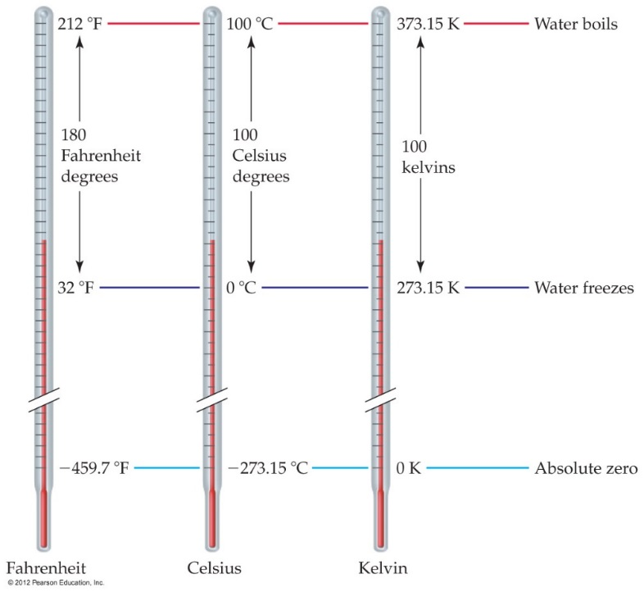
Temperature Scales
Three common temperature scales:
 | Fahrenheit | Celcius | Kelvin
B.P. of water | 212◦F | 100◦C | 373.15 K
Body Temp | 98.6◦F | 37.0◦C | 310.15 K
Room Temp | 68◦F | 20◦C | 293 K
M.P. of water Standard Temp | 32◦F | 0◦C | 273.15 K
Absolute Zero | – 459.7◦F | – 273.15◦C | 0 K

Slide 5
Historical Barometers
Vacuum
Aristotelian belief was that
air is weightless
vacuums pull on their surroundings
What is a barometer?
Invert a column of water in a test tube
Same result as a test tube until the tube is 10.3 m (34 ft) tall
Any taller leaves a space above the column of water
No matter how tall you make the tube, the water will rush out of the tube until the water column is 10.3 m tall, leaving a vacuum above the water in the tube.
https://www.youtube.com/watch?v=HUmZrtiXDik World’s Longest Straw
10.3 m

Slide 6
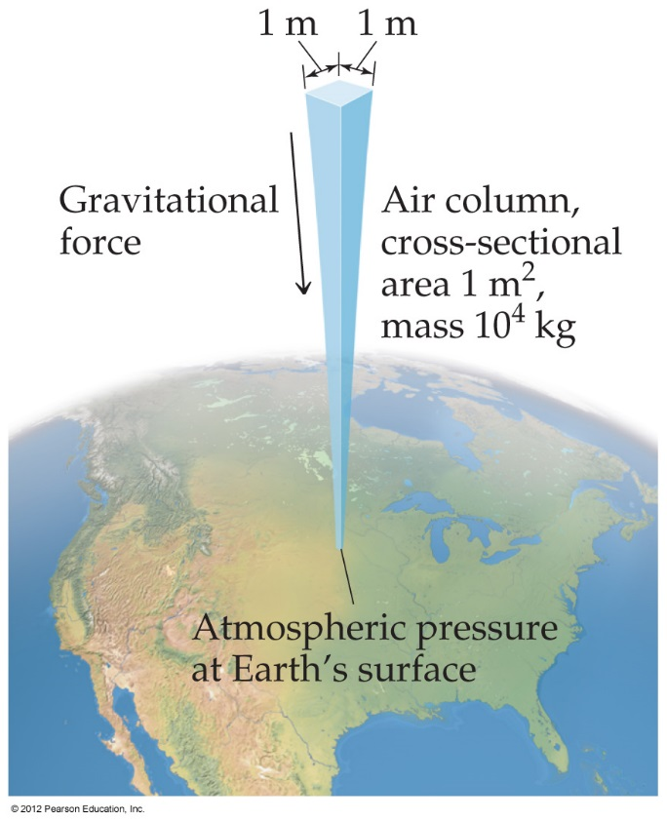
Pressure
Pressure is the amount of force applied to an area:
Atmospheric pressure is the weight of air per unit of area.
F
A
P =

Slide 7
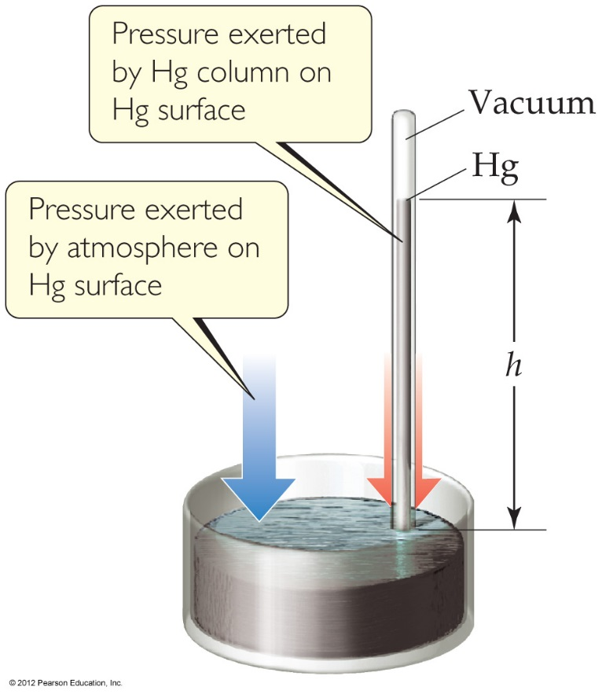
Units of Pressure
Pascals (SI Unit)
1 Pa = 1 N/m² 1 kPa = 1000 Pa
mmHg or torr
Height of mercury column
1 Atmosphere= Standard Pressure
1.00 atm = 760 torr = 101,325 Pa
English units
=14.69 pounds per square inch or psi (tires)
=29.92 inches of Hg (weather reports)
Standard Temperature and Pressure
STP = 1 atm and 0°C

Slide 8
Practice Converting P and T
1.00 atm = 760 torr = 101,325 Pa
Convert 685 mmHg to atm.
Convert 1.20 atm to mmHg
Convert 123 kPa to torr
Convert 30.2” Hg to atm
Convert 38°C to Kelvin
Convert 313 K to Celcius

Slide 9
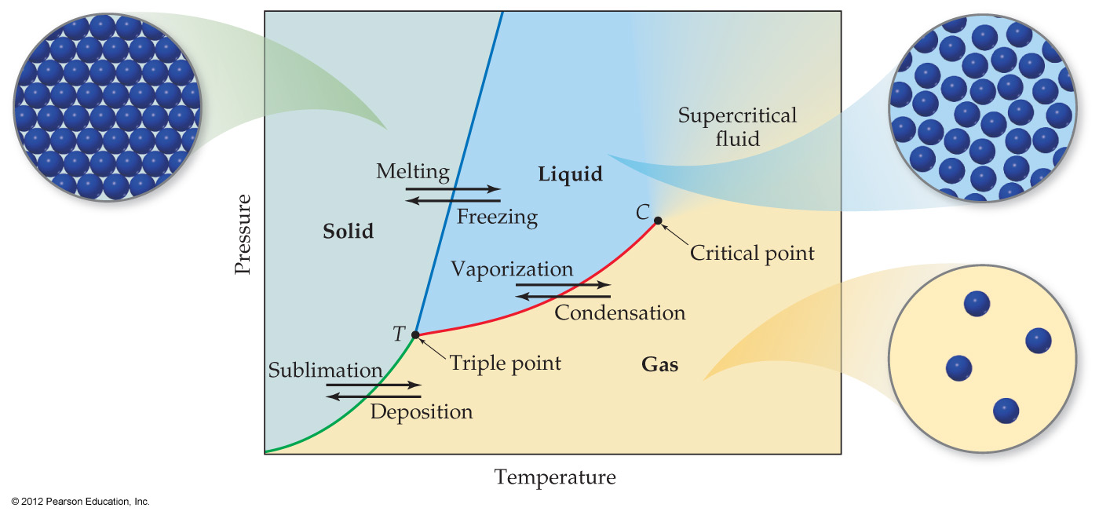
Phase Diagrams
Phase diagrams display the state of a substance at various pressures and temperatures, and the places where equilibria exist between phases.

Slide 10
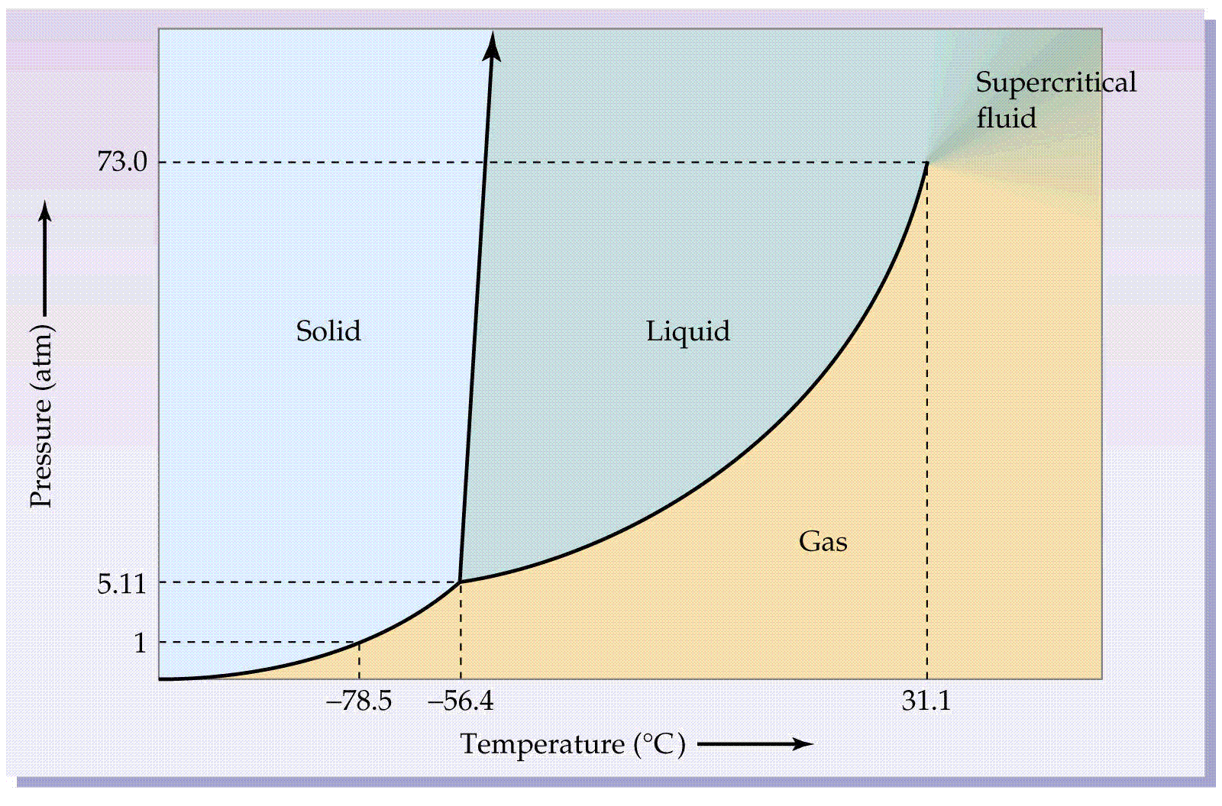
Phase Diagrams for H₂O and CO₂
Triple point of water high speed video

Slide 11
Exit Slip - Homework
Exit Slip: Sketch a basic phase diagram. Label the three states of matter, the triple point and the critical point.
What’s Due? (Pending assignments to complete.)
Pressure- Temperature Worksheet
Complete the Separation Lab report
What’s Next? (How to prepare for the next day)
Energy, p38-45

